Slide 1
Noget med genrer
Sofus, Eliot, & Mads
Applied Machine Learning 2021 final project
Niels Bohr Institute

Slide 2
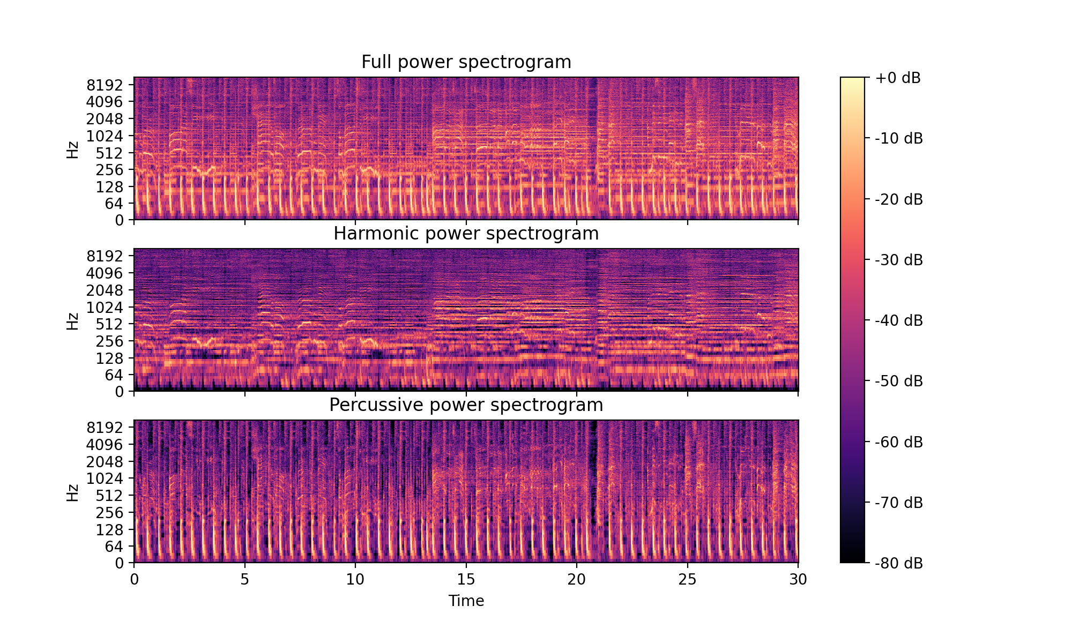
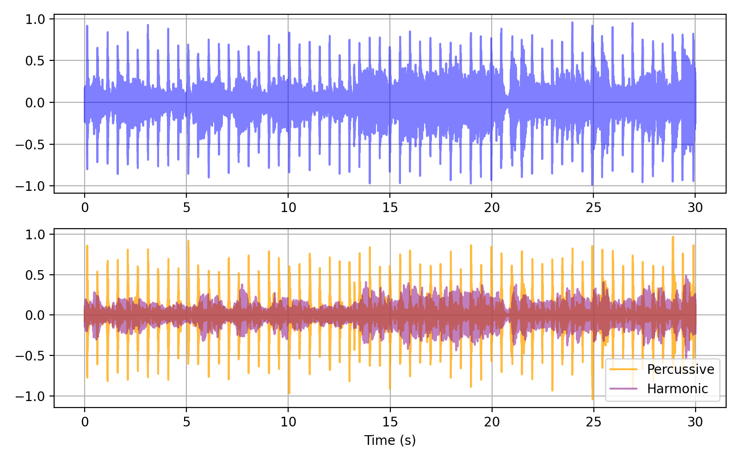

Harmonic Percussive Source Separation
Median filtering of spectrogram
Analyse melodic and rythmic features separately
For details on HPSS, see: Derry FitzGerald Proc. of the 13th Int. Conference on Digital Audio Effects (DAFx-10) (2010)

Slide 3
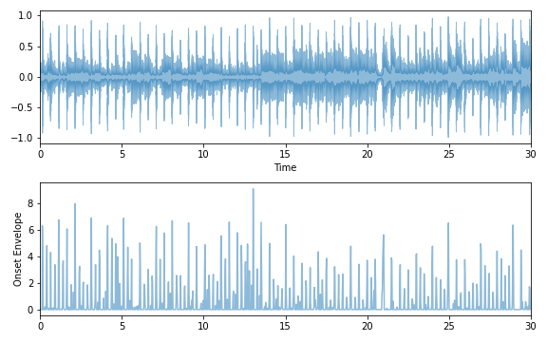
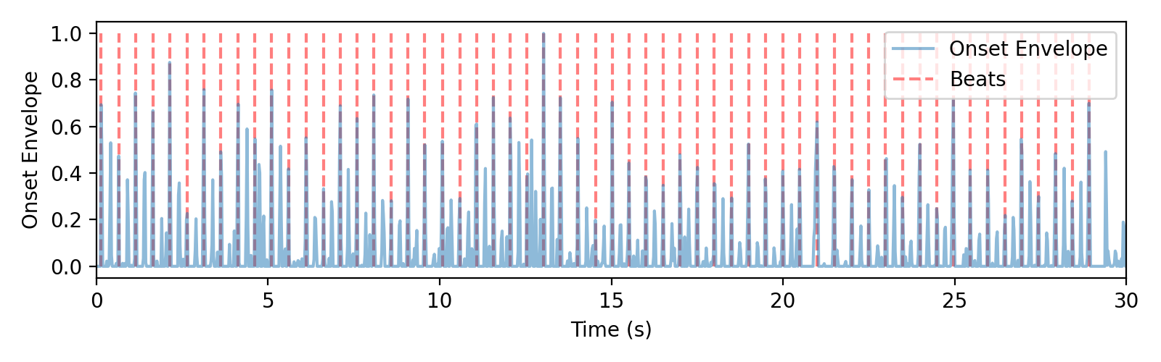
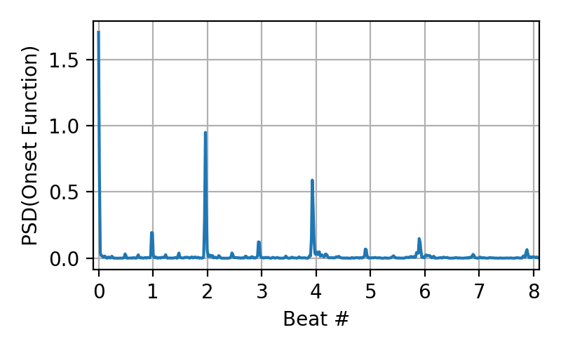
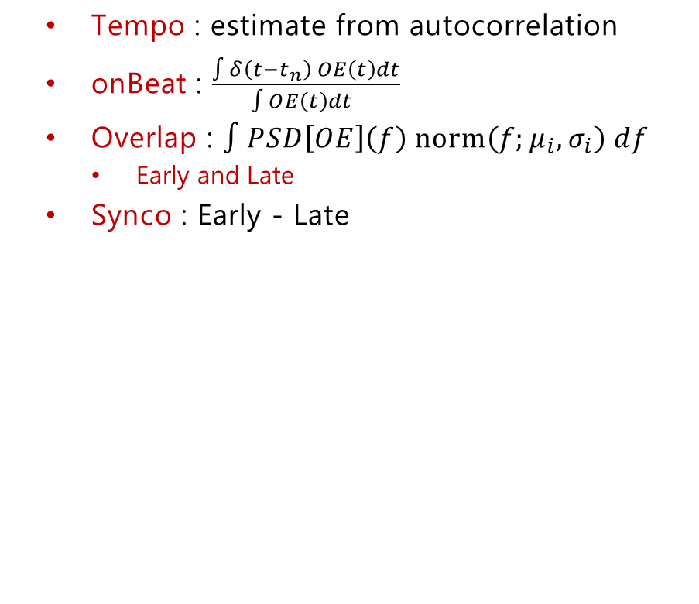
Rythmic features
Tempo : estimate from autocorrelation
onBeat : $\frac{∫δ\left(t−t_{n}\right) OE\left(t\right)dt}{∫OE\left(t\right)dt }$
Overlap : $∫PSD\left[OE\right]\left(f\right) norm\left(f;μ_{i},σ_{i}\right) df$
Early and Late
Synco : Early - Late

Slide 4
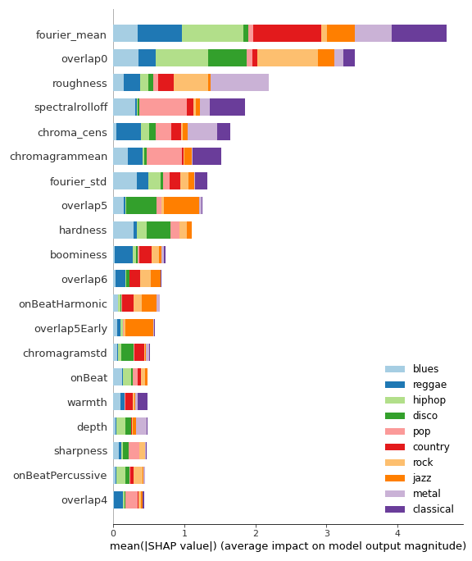
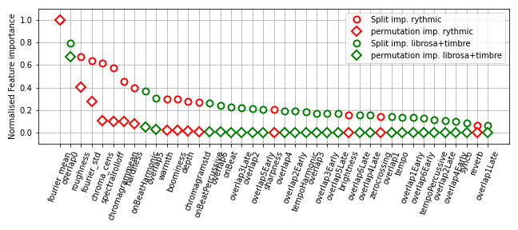
Feature Importance
Permutation (10 repeats) and split importance
SHAP values
… Homemade features are competitive!

Slide 5
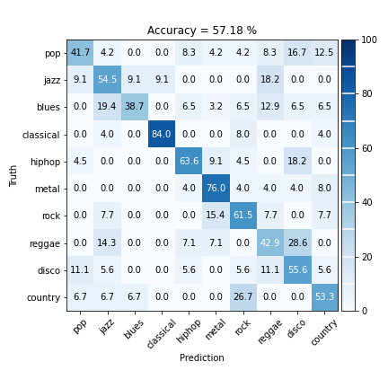
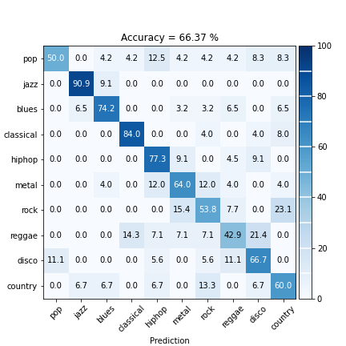
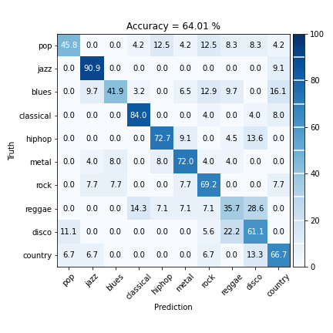
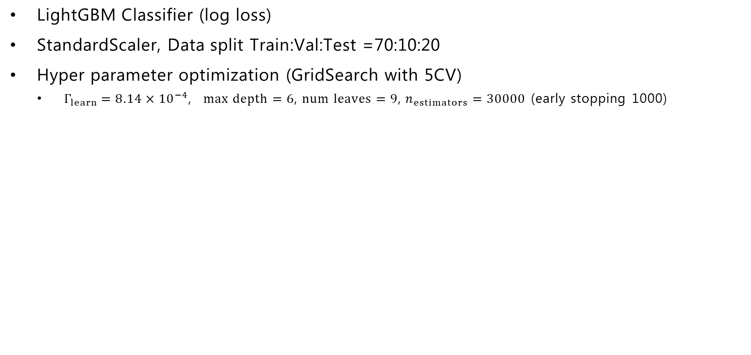
Improvement?
LightGBM Classifier (log loss)
StandardScaler, Data split Train:Val:Test =70:10:20
Hyper parameter optimization (GridSearch with 5CV)
$Γ_{learn}=8.14×{10}^{−4}$, $max depth=6$, $num leaves=9$, $n_{estimators}=30000$ (early stopping 1000)
Modest improvement!
Librosa & timbre: All 41 variables: Top 10 variables:
Truth

Slide 6
Summary and outlook
Rythmic features improves model somewhat
Surprising for me that ”Early” & ”Late” variables aren’t more important
Many variables, little data...
Get more data
Dimensionality reduction
Recursive feature elimination
More advanced hyper parameter optimization

Slide 7
Appendix

Slide 8
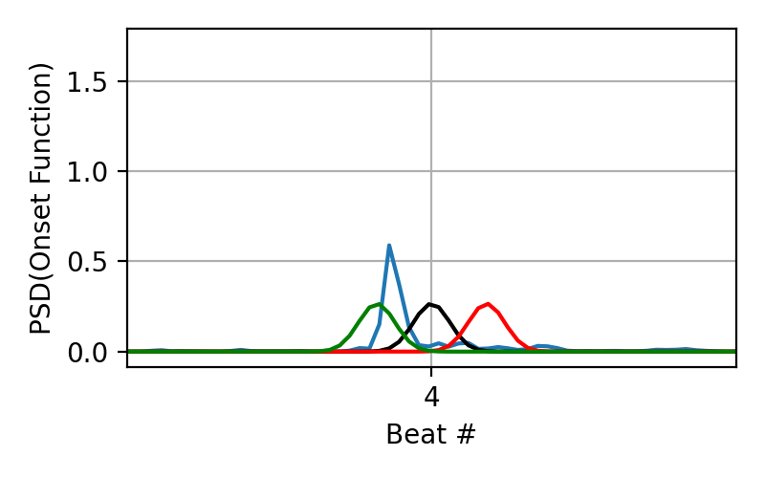
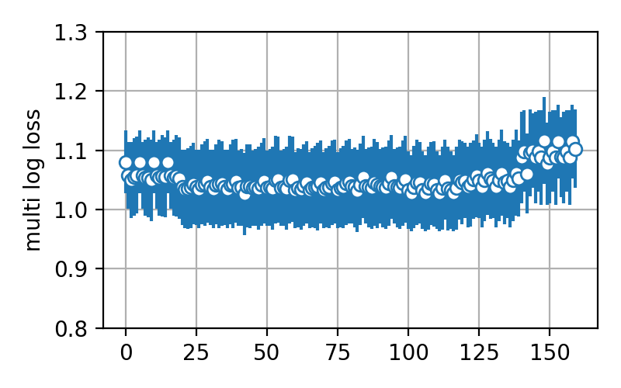
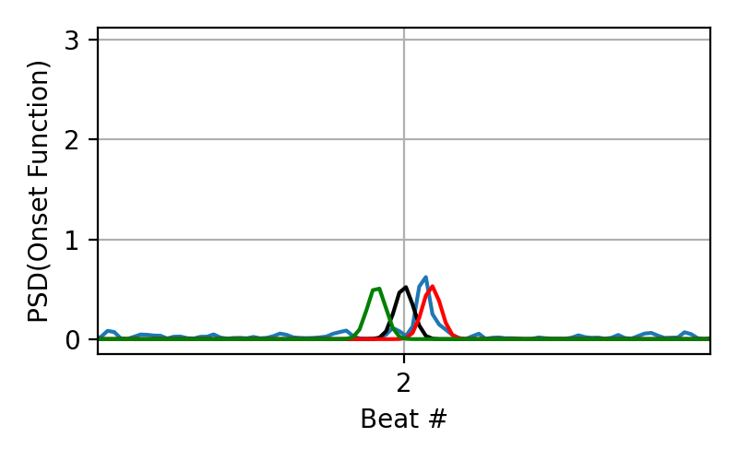
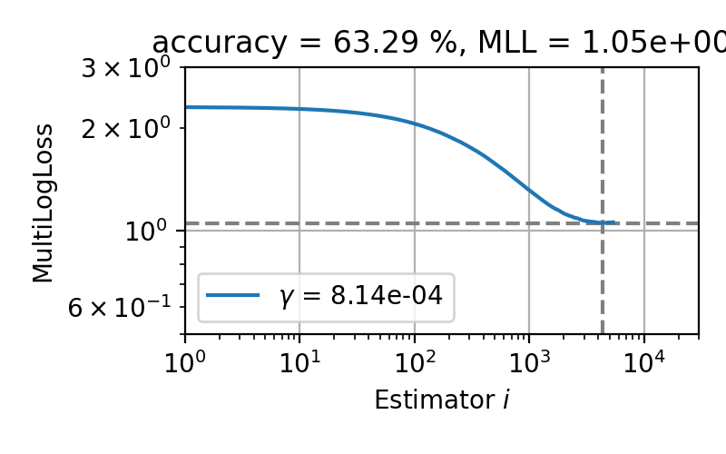
Extracted features, training
Early/Late at beat 4 for disco4
Early/Late at beat 2 for blues12
Loss in grid search
Validation loss best hyper params

Slide 9
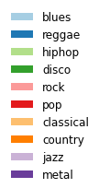
Top12 Pairplot
Fourier_mean
Overlap0
Roughness
Spectralrolloff
Chroma_cens
Chromagrammean
Fourier_std
Overlap5
Hardness
boominess
Overlap6
onBeatharmonic

Slide 10
